Slide 1
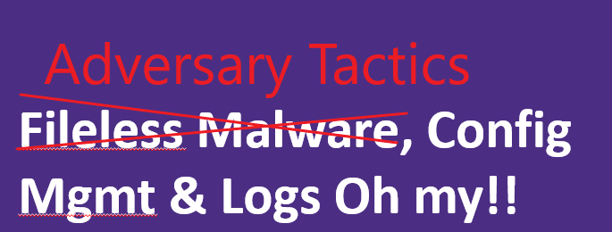

Security Awareness!
Notes:
This is a security awareness training… It will show some ways a Red team person will get in and how blue team detects.
This is originally created for a MeetUp presentation intended to provide System Admins and System Engineers awareness of some Red Team Tactics and some things that can be done to detect prevent.
This is a highly technical talk with Acronym/Hacker-nyms like wmic, powershell, smb, llmnr
This is also heavily focus on Windows operating systems and familiarity with some system admin tools and Linux cmd prompt are assumed.

Slide 2
Disclaimer
WARNING…
Following presentation contains my thoughts, ideas and opinions. They do not represent those of my current or past employers.
Any events, characters and company depicted in the course of this presentation are purely fictitious. Any similarity to actual events, characters and company is merely coincidental. <-Like South Park!
Do not use these tactics/techniques presented for evil.
Notes:
Disclaimer.

Slide 3

WHO Am I?
Red Teamer (Hacker)
¯\_(ツ)_/¯
Jesse Moore
Previously: Threat Detection and Response Team @ UW Medicine.
Currently: Cybersecurity Advisor @UW Bothell
Education:
Bachelor’s of Science IT Security
GIAC Penetration Tester | Forensic Analyst
https://www.linkedin.com/in/jessefmoore/
Jessefmoore+DFIR@gmail.com
Notes:
Who Am I?
Red Team hacker
A red team or the red team is a group that challenges an organization to improve its effectiveness by assuming an adversarial role or point of view.
Certs:
WhiteHat Secure Developer
Metasploit pro certified specialist
CyberSecurity Forensic Analyst
Cisco CCNA –Security
Next Slide is “We Can Defend”

Slide 4

Together We Can Defend!
Security depends on US! Yep, more stuff to do…
Reference: http://www.washington.edu/boundless/
Notes:
Together we can defend!
System engineers (Operating system Secure configs/Patches Software/Monitors systems), Network Engineers that segment the environment (DMZ, Production/Test and Block port services)
Next Slide: What is the Agenda?
https://www.meritalk.com/articles/cyber-education-must-address-systems-engineering-nist-official-says/

Slide 5
What is the Agenda?
…
Red Team tactics and techniques
Defense approaches
Center of Internet Security Benchmarks
Logging (CheatSheets)
Monitoring (via Sysmon)
Notes:
Next Slide: Rocky and Segway to Red Team tactics

Slide 6

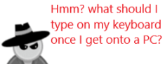
Red Team Tactics What exactly is that?
Reference: https://gallery.technet.microsoft.com/Azure-Security-Center-549aa7a4
Notes:
Context will be around CCDC however these tactics is being done everywhere… University, Private companies, you name it.
(in all sorts of programing and scripting languages, not just PowerShell.)

Slide 7
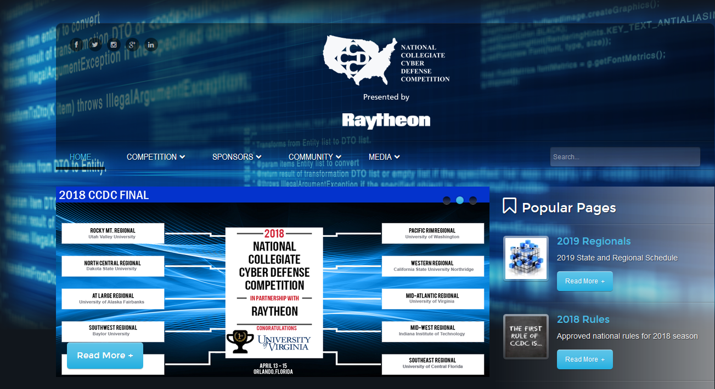
Who has heard of Collegiate Cyber Defense Competition (CCDC)?
http://www.nationalccdc.org/
Notes:
The mission of the Collegiate Cyber Defense Competition (CCDC) system is to provide institutions with an information assurance or computer security curriculum a controlled, competitive environment to assess their student's depth of understanding and operational competency in managing the challenges inherent in protecting a corporate network infrastructure and business information systems.
This is a fast pace environment (need to automate where possible.)
Work as a team to compromise a network (AD, domain attached workstations, DNS servers, WordPress WebSites, OWA email and Win2012 servers exchange, etc)
3. I am on the Red Team for Pacific Regionals
UW won last year!
Its 12 teams of about 5 on each team for Blue Teams. And half that for Red Team (they get two blue teams each)
Its at Highline college
CCDC Events are designed to:
Build a meaningful mechanism by which institutions of higher education may evaluate their programs
Provide an educational venue in which students are able to apply the theory and practical skills they have learned in their course work
Foster a spirit of teamwork, ethical behavior, and effective communication both within and across teams
Create interest and awareness among participating institutions and students

Slide 8
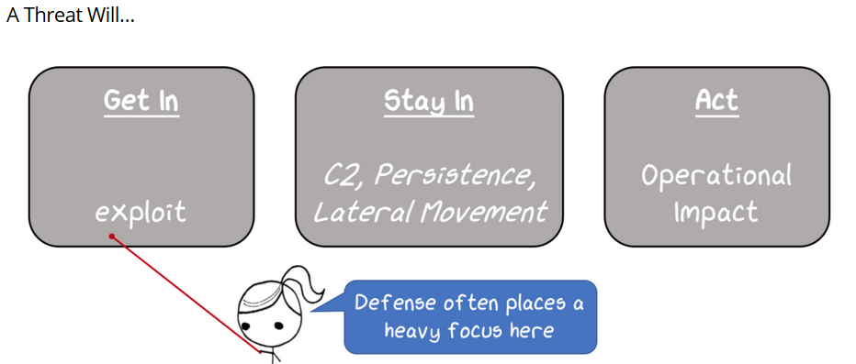
Okay, lets talk Attack!
…
https://http://threatexpress.com/2018/06/threat-gets-a-vote-applying-a-threat-based-approach-to-security-testing/
Notes:
We will talk about (STAY IN) C2, Persistence and lateral movement
Next Slide: Lets visualize the Red Team infra with Phishing.
Some would say that most compromises start with phishing.

Slide 9
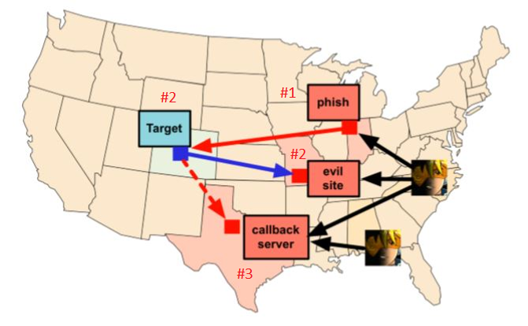
Red Team Phishing infrastructure
Send Phish via Cobalt-Strike
Target clicks & or goes to EvilSite to obtain and execute malware
Then Target calls Cobalt-Strike server waiting for Adversary commands
https://www.cobaltstrike.com/downloads/csmanual311.pdf
Notes:
1. This shows a red team infrastructure and how they setup and implement C2.
2.Now that we are on a target system (could be your windows workstation)
Next Slide: GUI of adversary workstation and their Command and Control
Phish → Creds -> System Access->Empire C2C
Phish → Creds -> System Access-> Meterpreter

Slide 10
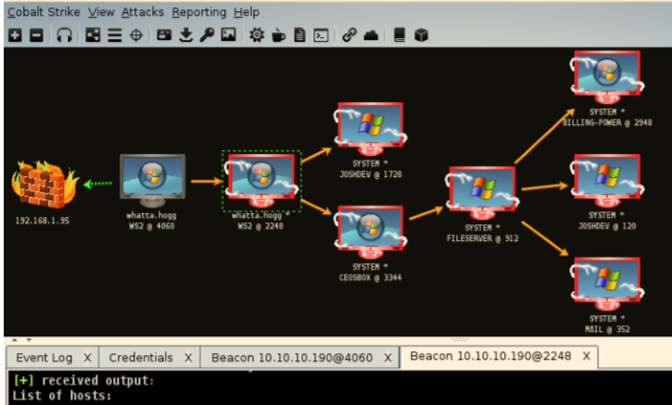

After Phish Click! Cobalt Strike- Adversary simulation software.
https://www.cobaltstrike.com/downloads/csmanual311.pdf pg.12
Notes:
1. After CLICK Here we have a foot hold (compromised a computer)
2. Then you can see with the lightening bolts how I have moved laterally through the network. Maybe using WMIC (recon or exploit) or SMBexec (pass the hash) or LLMNR to perform Multi-relay attack via SMB
3. Windows Management Instrumentation (WMI) Command-Line Utility (Wmic.exe)
4. Pass the Hash is when you take the ntlm version of your password that the systems stores as your password
5. This is a team server for attackers so everyone can share credentials and other attacks.
I could get screenshots, kill processes and then keylogger to obtain your passwords
NEXT SLIDE: some things I do on a cmd prompt at the competitions…
What is CS?
CS is adversary simulation software designed to execute targeted attacks and emulate the post-exploitation action of advanced threat actors.

Slide 11
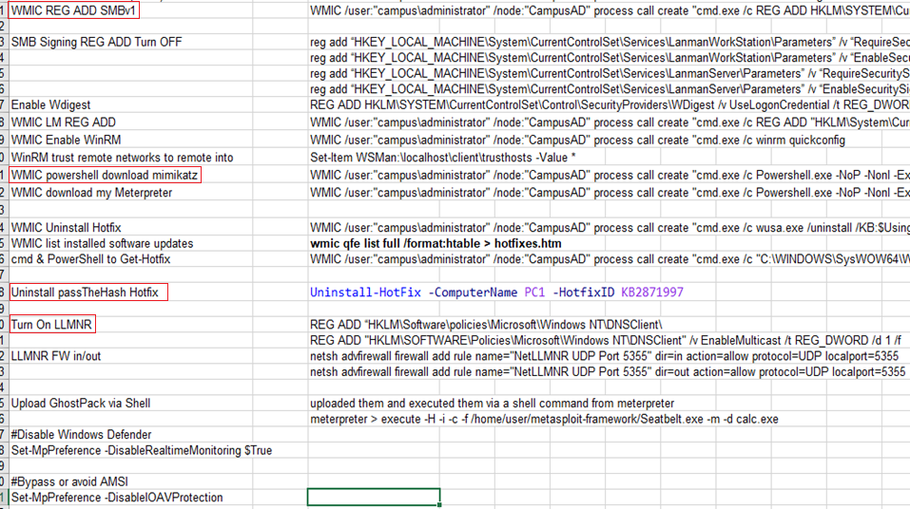
My Adversary Techniques/Procedures
Notes:
As seen earlier I was on a machine; Then from there I move laterally. Using WMIC to help and persist, download C2, dump creds, make vulnerable
Windows Management Instrumentation (WMI) Command-Line Utility (Wmic.exe)
1. SMBv1 allows lateral movement (Eternal Blue, NSA exploit) WHAT is the EternalBlue or NSA exploit?
2. WMIC to launch powershell to download mimikatz – Mimikatz is a password stealer.
3. Turn on LLMNR (which is a DNS at the host level) if it can’t get a response from DNS is asks the subnet its on for where a Url or Fileshare is.
4. Uninstall passThehash hotfix (passthehash is where you are able to obtain the ntlm (LM) hash of the password and use that instead of the actual password)
NEXT SLIDE: Look at LLMNR SMB attack

Slide 12
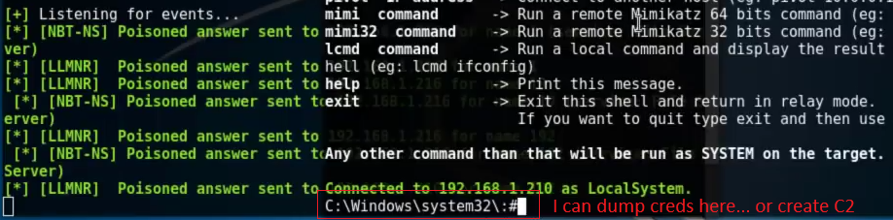
LLMNR Relay Attack
(LLMNR) = Link-Local Multicast Name Resolution (Port 5355)
LLMNR Attack (10:36 minutes into it)
https://www.youtube.com/watch?v=rjRDsXp_MNk&t=627s
Tool listens on TCP 80, 3128 and 445, needs SMB signing off and wait for the user to request the wrong web address, or fileshares, etc.
Notes:
Consider this Local DNS and just uses the subnet its on to ask hosts
Mistyped File servers names or URLs will engage LLMNR
Responder tool listens on TCP port 80, 3128, and 445. & needs SMB Signing off (NTLM authentication/encryption used)
Video starts at 8:45 with python Responder –I
4. Then you can get creds or make it install a C2
NEXT SLIDE: is Cobalt Strike post exploitation software (AUTOMATION and Team Server)
LLMNR has been documented as an informal RFC by the IETF in RFC 4795 (January 2007) http://www.ietf.org/rfc4795.txt
https://tools.ietf.org/html/rfc4795
https://medium.com/@rootsecdev/an-in-depth-look-at-server-2019-and-windows-10-rs5-security-baselines-52508a986c16
NTLM Challenge/Response Relayed Explained:
https://www.youtube.com/watch?v=nKkcd_gsOtw

Slide 13
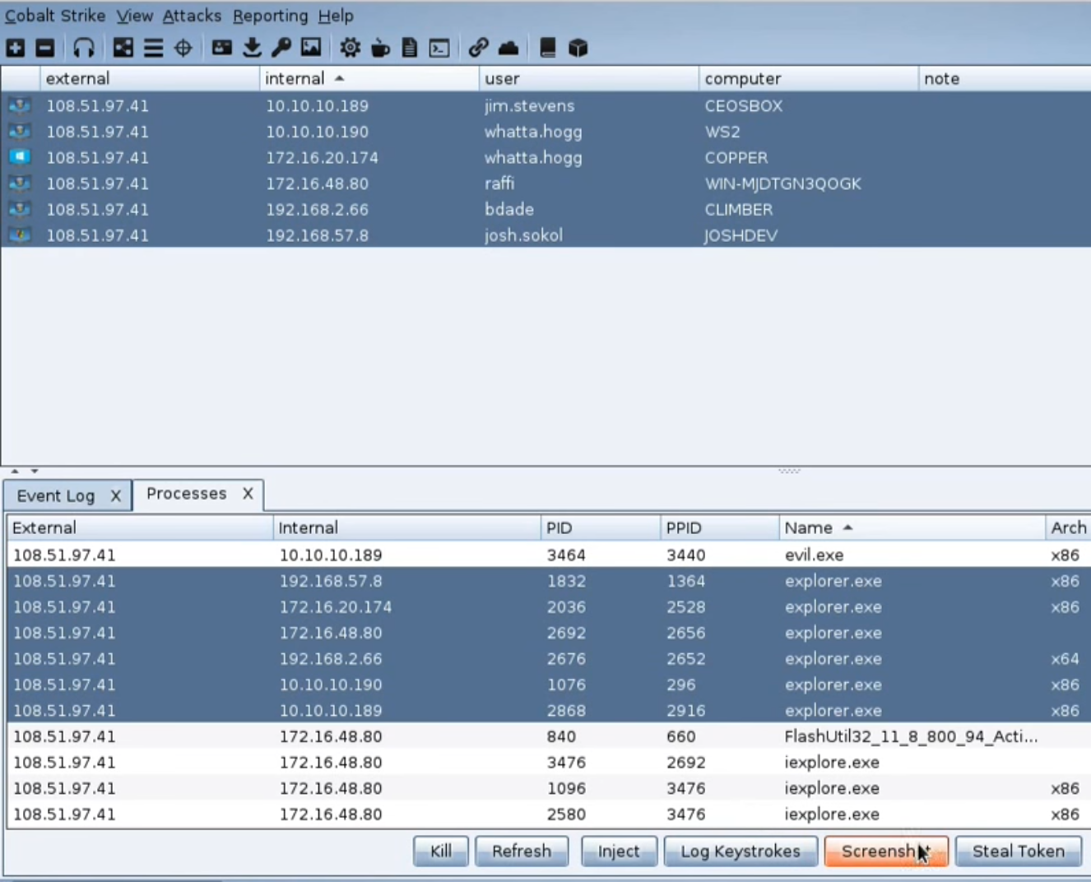
Cobalt Strike- Adversary simulation software.
https://www.cobaltstrike.com/downloads/csmanual311.pdf pg.12
Notes:
Automate at scale the attacks.
1. Take Screenshots to see what user is doing
2. Kill a process (Application) to make a user type a password
3. Log keystrokes to obtain the typed password
NEXT SLIDE: CS Scripts.

Slide 14
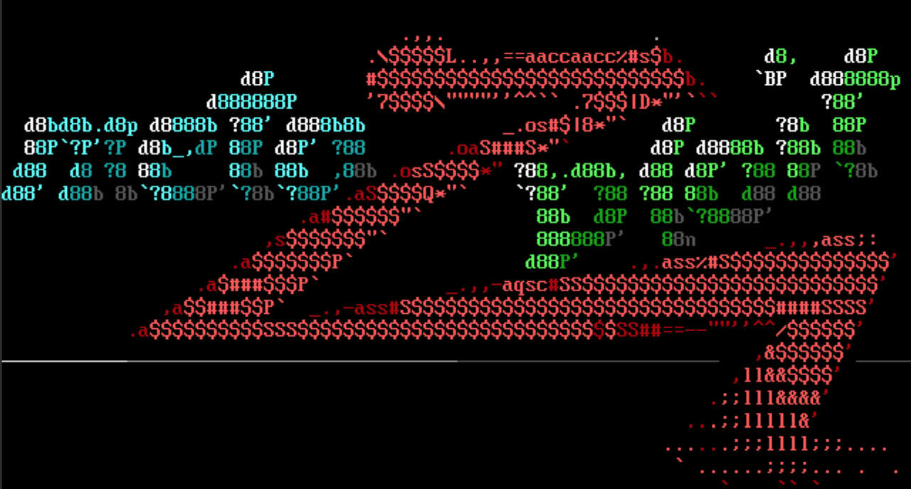
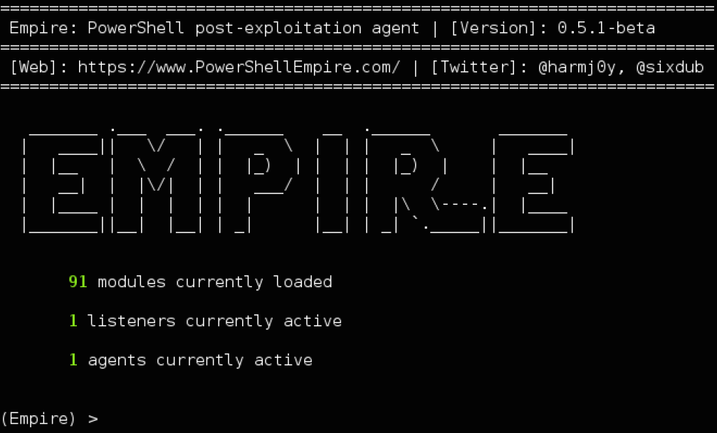
Adversary | Metasploit | PowerShell Empire
Reference:
https://www.metasploit.com/
https://www.powershellempire.com/
Notes:
We can use many tools (lots of GitHub)
What is Empire?
Is a Post-Exploitation software and can emulate the post-exploitation action of advanced threat actors.
https://github.com/EmpireProject/empire/wiki
What is Metasploit?
Metasploit Framework, a tool for developing and executing exploit code against a remote target machine.
https://en.wikipedia.org/wiki/Metasploit_Project
NEXT SLIDE: Deep inside of Empire

Slide 15
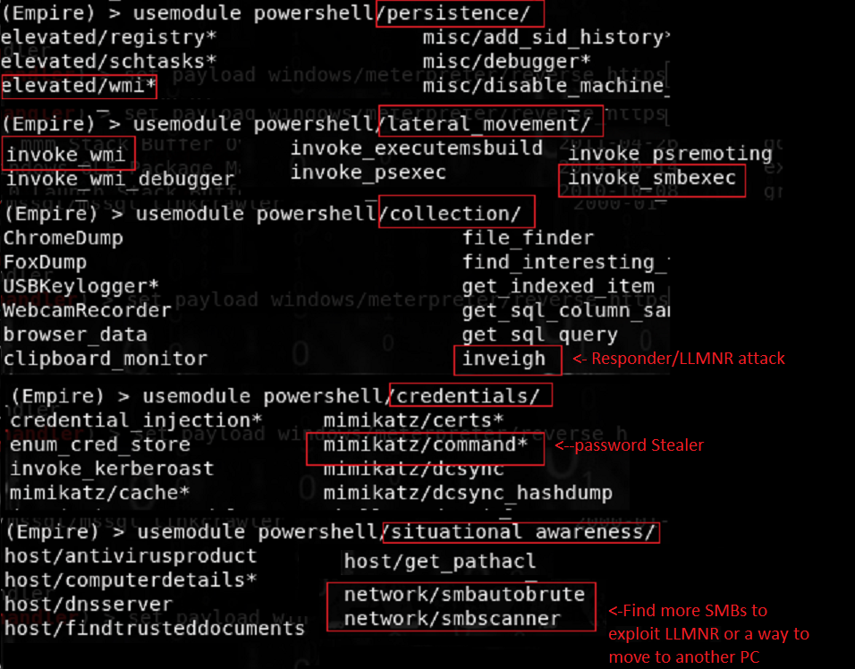
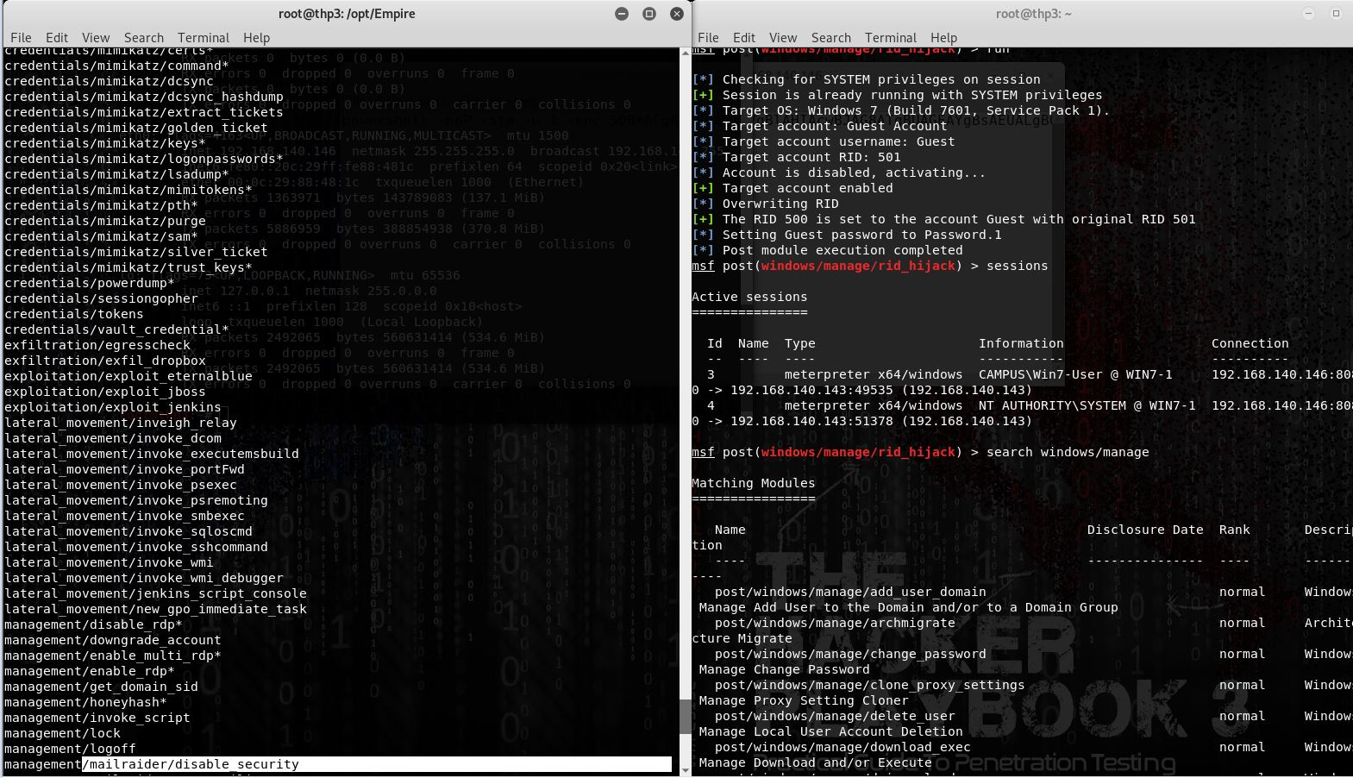
Empire | Metasploit | Adversary Techniques?
PowerShell Empire…
Notes:
1. LateralMove/ Invoke-smbexec (pass the hash) to get to another box
Invoke-SMBExec performs SMBExec style command execution with NTLMv2 pass the hash authentication. Invoke-SMBExec supports SMB1 and SMB2.1 with and without SMB signing.
2. Lateral_movement/Invoke-wmi (allows you to stage on target and execute launcher through WMI, which will give you an Agent.
3. EternalBlue NSA exploit (what is it?) to exploit SMBv1 being open (no creds required)
NEXT Slide: Lets talk more about PowerShell Empire
https://www.metasploit.com/
https://www.powershellempire.com/

Slide 16
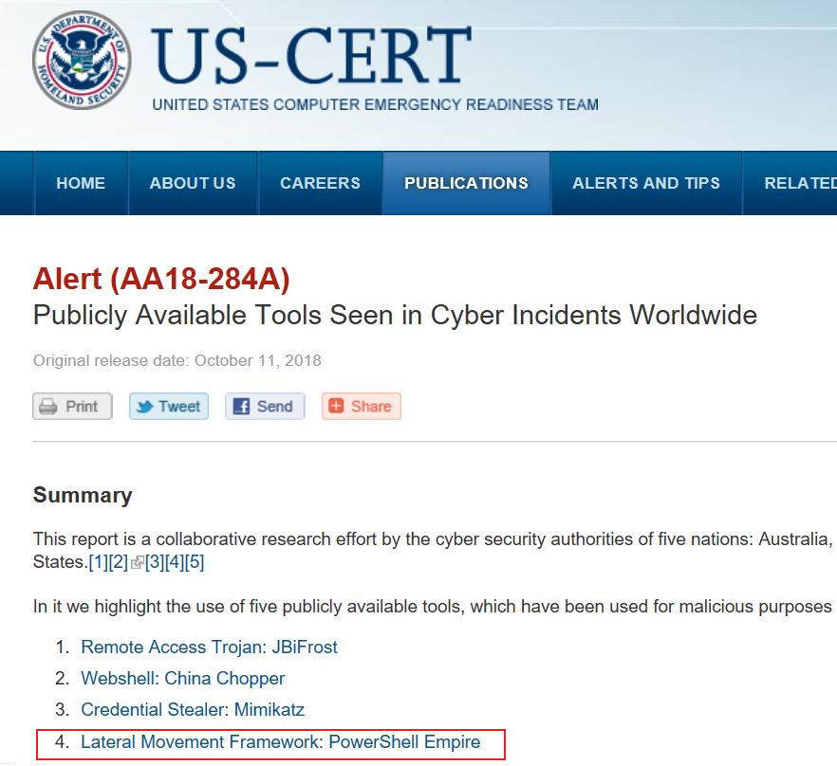
US-CERT (PowerShell Empire)
…
Reference: https://www.us-cert.gov/ncas/alerts/AA18-284A
Notes:
1. US-Cert and PS Empire is bad (as you can see US-CERT recognizes adversaries are using this tool)
Let’s use this PowerShell Empire as an example..
NEXT SLIDE: PowerShell Empire Demo

Slide 17
Perform in-Memory (Empire) Attack!
…
DEMO
- C2C from Excel MACRO (Click enable Content)
https://screencast-o-matic.com/u/vqZ/BuildMacroExploitEmpire
Notes:
1. Show how simple it is to make Macro and get Command and control of PC and go over another 3 things.
2. Start at 2:40 to generate Macro
Mimikatz at 7:08
8:46 (Peristence-wmi, registry, then Situational Awarness SMB stuff, PowerView)
Collections at 11:42 (until 11:44) with keylogger, Inveigh (LLMNR)
Next SLIDE: NOW to switch gears to Talk about Defense and Scripting Engines and logging capabilities. Especially PowerShell

Slide 18
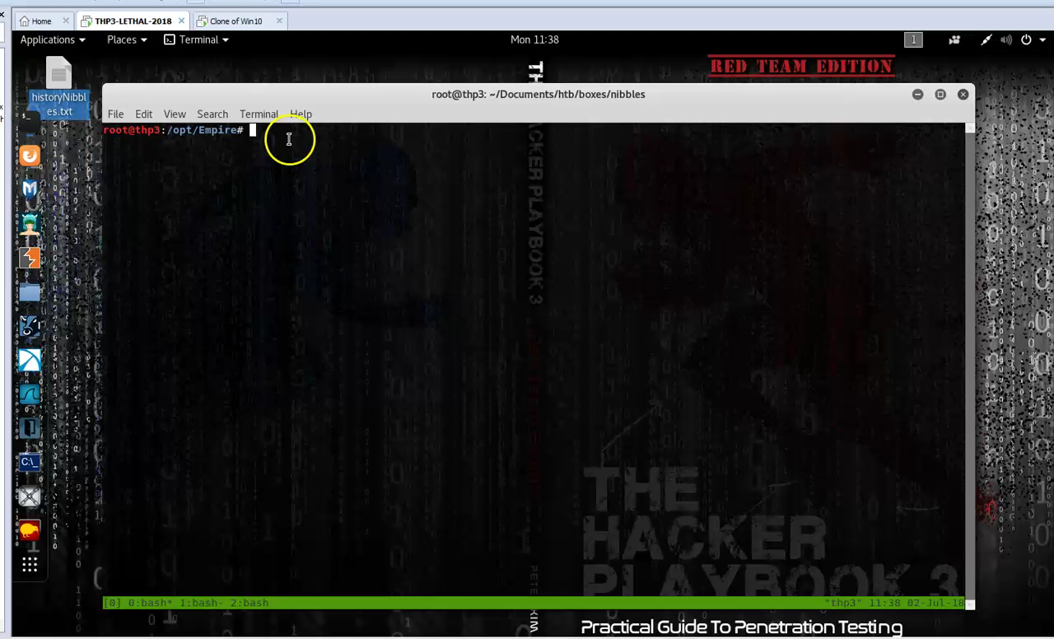

Slide 19
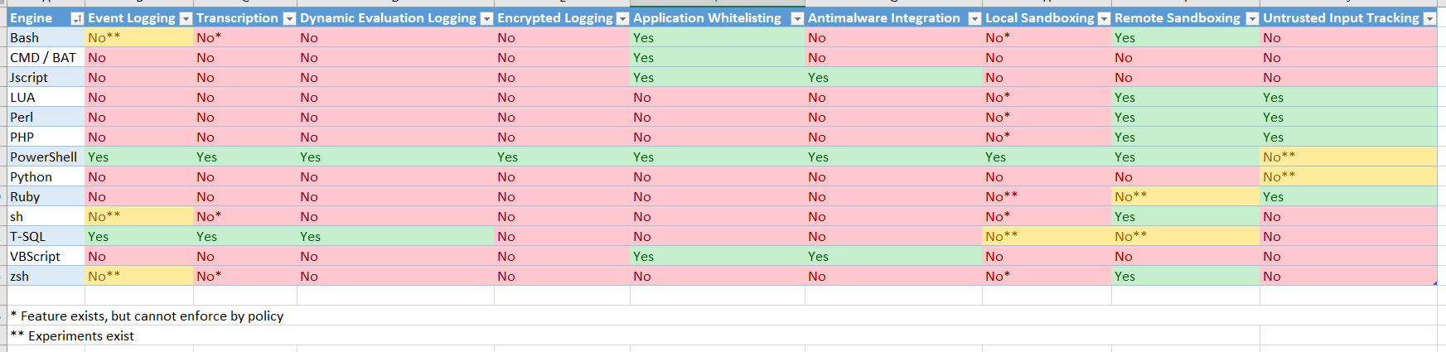
Adversary Scripting Languages, Why use one over the other?
Go to site and get more info, the take away here is that we need to Focus on behavior to catch the sneaky attackers.
Assume compromise and detect All-The-Things.
Reference: https://blogs.msdn.microsoft.com/powershell/2017/04/10/a-comparison-of-shell-and-scripting-language-security/
Notes:
1. Look at that! PowerShell has almost complete logging capabilities… At least turn that on. Especially since a popular attack infra is Empire.
2. So what do you do about all the engines that don’t log? Use Sysmon!
Next SLIDE: Sysmon will capture network, registry, wmi, process created plus much more..

Slide 20
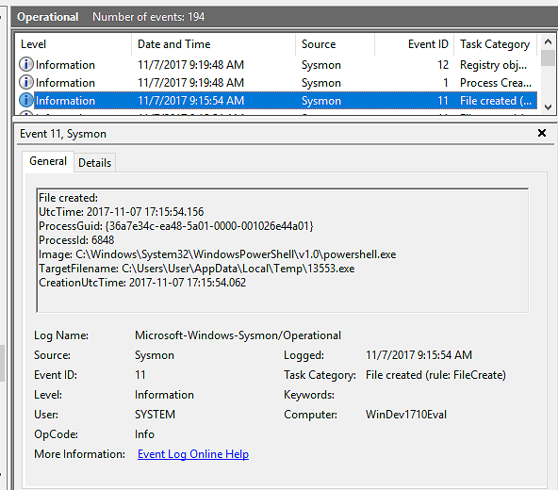
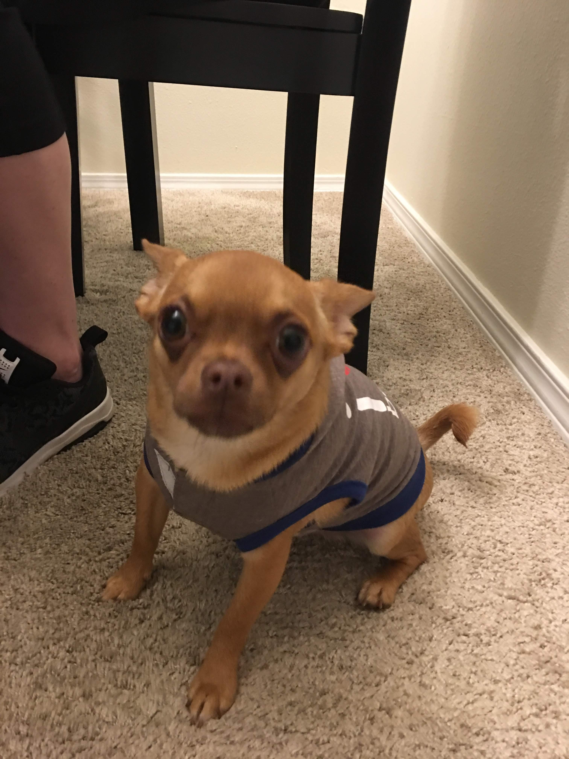
Turned On Sysmon. Oh no.. (says attacker)
Notes:
Sysmon includes the following capabilities:
1.Process Monitoring
2. Process Command
3. File Monitoring
Logs process creation with full command line for both current and parent processes.
Optionally logs network connections, including each connection’s source process, IP addresses, port numbers, hostnames and port names.
Detects changes in file creation time to understand when a file was really created. Modification of file create timestamps is a technique commonly used by malware to cover its tracks.
Assume compromise and detect All-The-Things.
Next Advance option is to gain visibility with ETW (Event Tracing for Windows)
ETW provides visibility into most core Windows subsystems, including:
Network activity
Process creation/termination
Thread creation/termination
Memory allocation
DLL load/unload
PowerShell method invocation
DNS resolutions (cached and hot)
Firewall activity
WMI activity
WinINet request/response headers
and so much more…
Let’s revisit the wishlist and consider how we answer some of those questions with existing ETW providers.
Wishlist Item ETW Provider Example Data
What DNS lookups did the process perform Microsoft-Windows-DNS-Client
What IP Addresses did the process connect to? Kernel Network Provider
How much data was transmitted by the process? Kernel Network Provider
173MB Is the process “beaconing” to a C2? Kernel Network Provider Yes, every 15 seconds
What DLLs did the process load? Kernel Image Load Provider System.Management.Automation.dll
Did the process create threads in other processes? Kernel Thread Provider Injected into winlogon.exe
What WMI operations did the process perform? Microsoft-Windows-WMI Registered an event handler backdoor
What PowerShell functions did the process call? Microsoft-Windows-PowerShell Invoke-Mimikatz

Slide 21
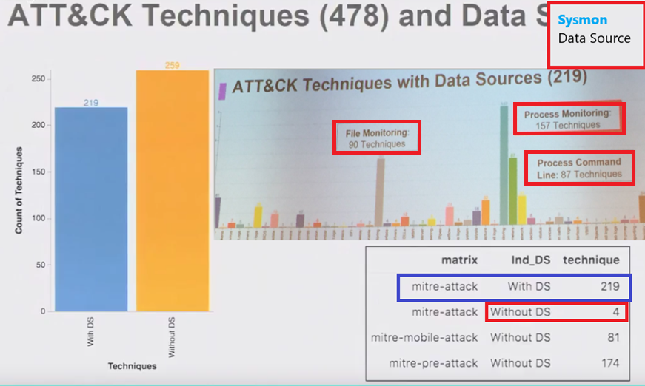
Data sources- Sysmon
Reference: https://github.com/Cyb3rWard0g/ATTACK-Python-Client
ATT&CKCon https://www.youtube.com/watch?v=LxzVtfw4WyQ
Notes:
1. Sysmon catches a lot of my techniques.
Process Monitoring
Process Command
File Monitoring
2. When I performed my WMI commands, or PowerShell cmds, or mimikatz , when I did stuff in Registry
NEXT SLIDE: So what are theses techniques?

Slide 22
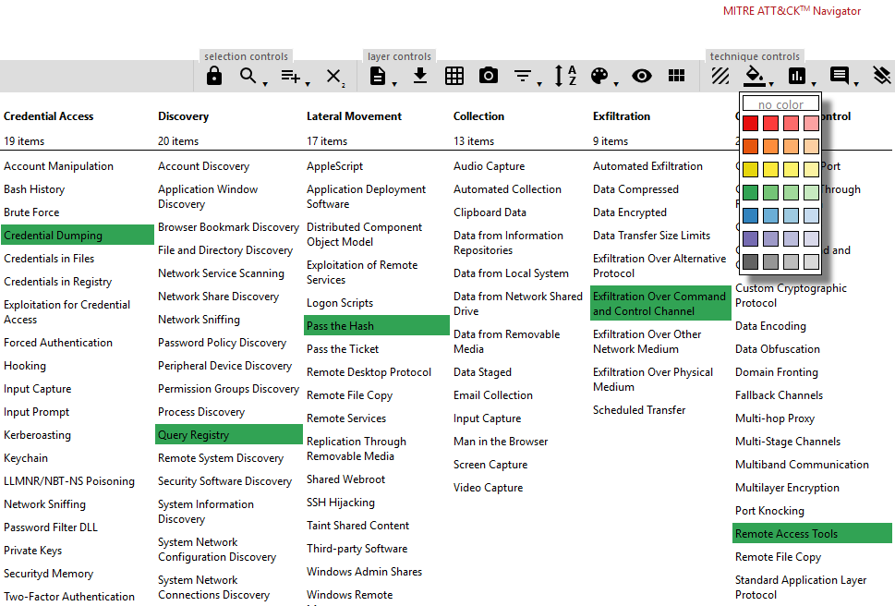
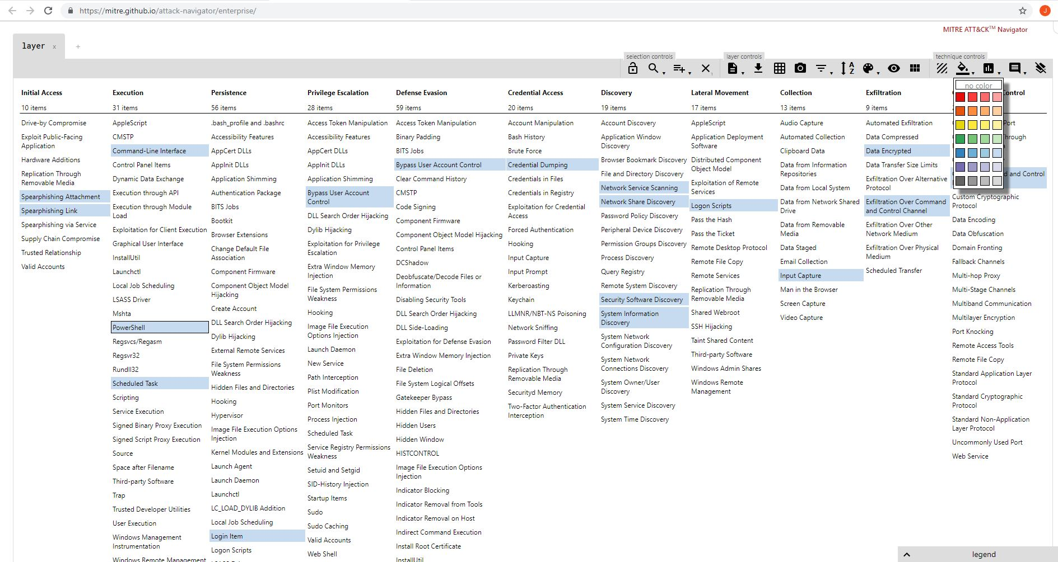
Use the Navigator to visualize your defensive coverage! https://attack.mitre.org/wiki/ATT%26CK_Navigator
…
Notes:
You can right click on anyone of these and get examples and details of what the attacks are.
Export this out to Excel and make graphs, etc to measure progress.
As a System admin/engineer there is so much to do and needs to be defended against.
NEXT SLIDE: Ok, cool got the techniques, how do I defend?
Have no fear CheatSheets are here!

Slide 23
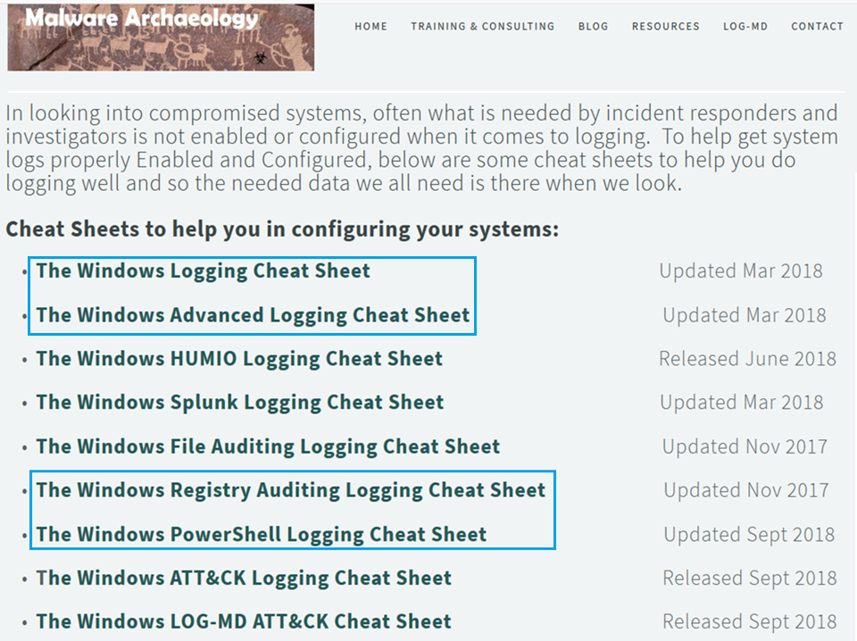
…
Notes:
Windows adv logging (cmd line auditing)
Registry Auditing will find my tactics
PowerShell Logging will find my Empire tactics
Lets now zoom out to a high level…. With CIS controls to double check if configs are secure.
https://www.malwarearchaeology.com/cheat-sheets
NEXT SLIDE: We have Center of Internet Security (CIS-CATS, Controls, Benchmarks)

Slide 24
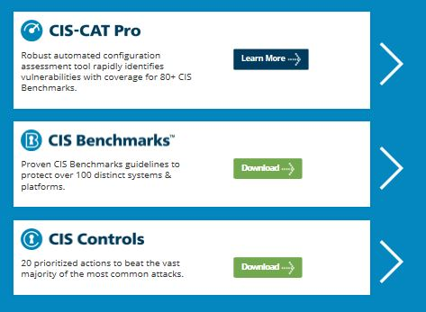
Being prepared… What can I do?
Where do I start? How do I prioritize?
Best Practices –OS Configs & Benchmarks
<- Automate ID of vulnerable configs
(Detailed StepByStep Guide)
<- Guidelines to protect systems
Detailed StepByStep Guide)
<- 20 Prioritized actions (High level)
Reference: https://learn.cisecurity.org/cis-cat-landing-page
Notes:
After the cheatsheets are implemented…
1. from the bottom we have High level actions prioritized. Says lets catch bad things… like a high level policy would say at organization. Must have (CS01) inventory of authorized and unauthorized assets, (CIS5)Secure configs for hardware/software, (CIS9/11) Limit & control of Network ports,
2. Then Benchmarks as detailed guides. The how to configure a Registry setting or disable ports and services like smbv1.
3. Then CIS-CATS, which automates assessment of benchmark. No human errors.
4. CIS provides AWS and Azure images that already meet benchmark configs.
NEXT SLIDE: Lets’ look at Benchmarks in more detail (PS)

Slide 25
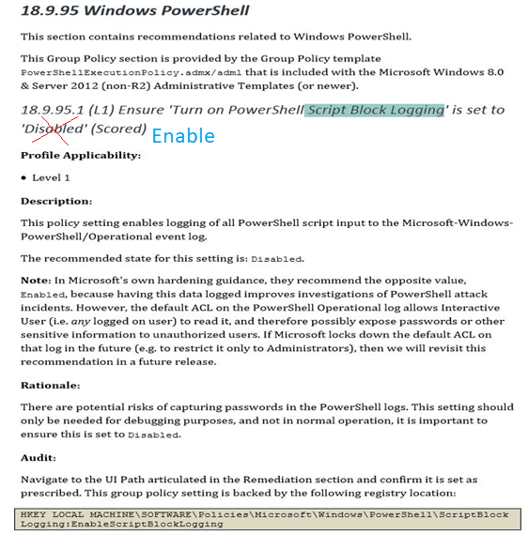
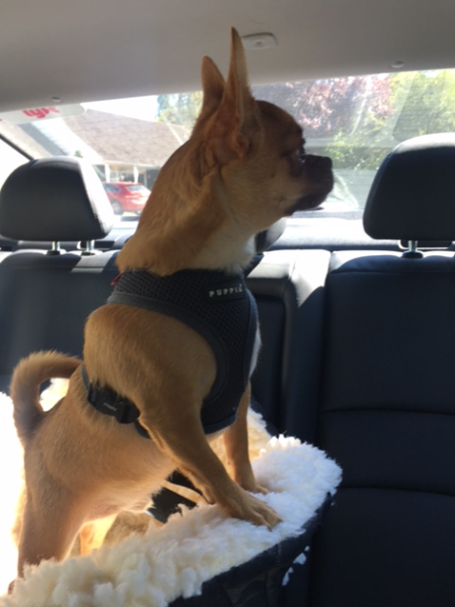
Enable Windows PowerShell Script block logging
Adjust…
Notes:
DON”T (disable) - PS Script block logging
- Set this to ENABLED!!!
Catch my PowerShell Empire stuff

Slide 26
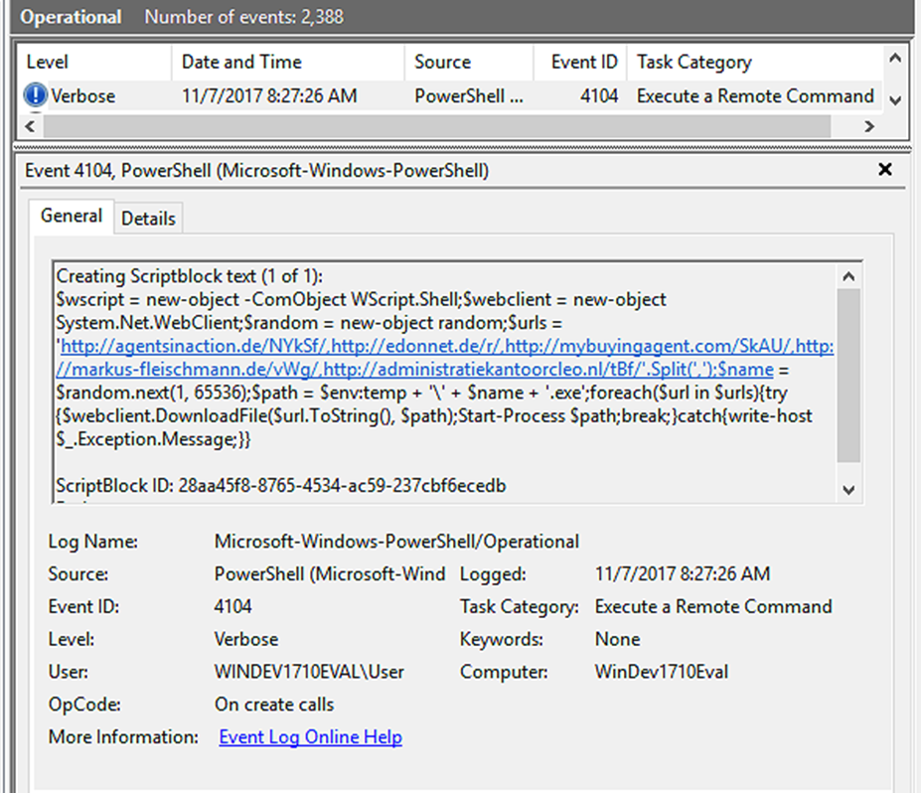

Enable PowerShell Script Block logging (Detection)
…
system)
Notes:
1. Enable Logging (even if you don’t have a central logging)
Catch my powershell Empire stuff.
2. This was a phish that used powershell base64 encoding
Ok, how do we even know about enabling logging or secure configs? CIS-CAT is a good start.
NEXT SLIDE: LLMNR benchmark

Slide 27
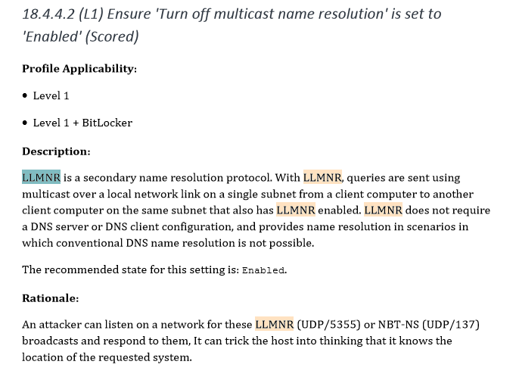
Benchmark: Turn OFF LLMNR
Disable LLMNR and NetBIOS in local computer security settings or by group policy if they are not needed within an environment
Reference: https://medium.com/@rootsecdev/an-in-depth-look-at-server-2019-and-windows-10-rs5-security-baselines-52508a986c16
Notes:
1. DO Disable LLMNR
2. What is this, you ask? This is DNS backup protocol, but uses the local network via multicast.
3. This will stop my credential harvesting creds or multiRelay lateral movement (getting to other PCs on network) Attack
Why should you care?
CIS Controls: 9 Limitation and Control of Network Ports, Protocols, and Services
https://attack.mitre.org/wiki/Technique/T1171
Monitor HKLM\Software\Policies\Microsoft\Windows NT\DNSClient for changes to the "EnableMulticast" DWORD value. A value of “0” indicates LLMNR is disabled

Slide 28
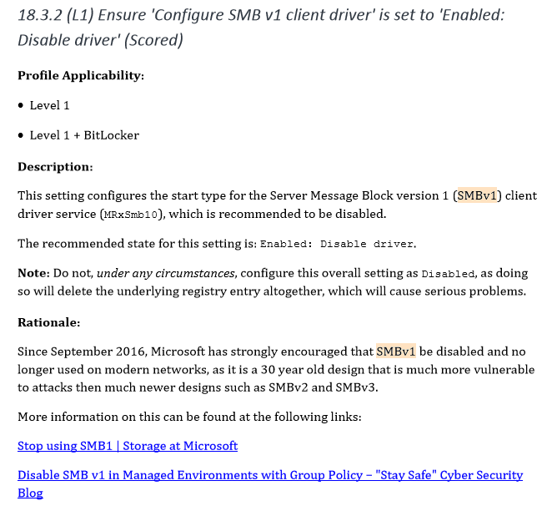
Benchmark: Disable Windows SMBv1
…
Notes:
1. Yes - it says SMBv1 to disable now
2. This will stop my lateral movement and exploits (NSA-Eternal Blue from the Internet especially).
3. Stop me from passing the hash in some cases
4. Make sure you don’t delete SMB in the registry, you must have that just use SMBv2 or 3.
NEXT SLIDE: CIS-CATS demo of how to do it on a system
https://www.blackhillsinfosec.com/how-to-disable-llmnr-why-you-want-to/
Windows systems make DNS/NetBIOS/LLMNR requests to find the domain controllers they logged into even when they are no longer attached to the domain.
https://room362.com/post/2016/12-29-buying-internal-domain-access/

Slide 29
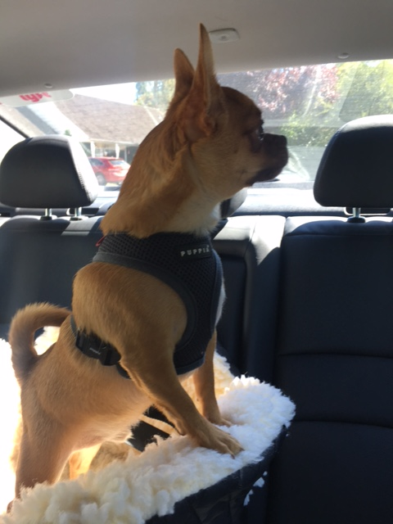
Perform OS Configuration Hardening!
Use Windows OS Configuration Benchmarks.. How?
DEMO
Automatically find Secure configs
CIS-CAT: Configuration Assessment Tool. https://screencast-o-matic.com/u/vqZ/CIS-CAT
Reference: Reference: https://learn.cisecurity.org/cis-cat-landing-page
Notes:
1. Now that we have a sneak peak of benchmarks lets see it in action…
NEXT SLIDE: End …. Take-aways from presentation.

Slide 30
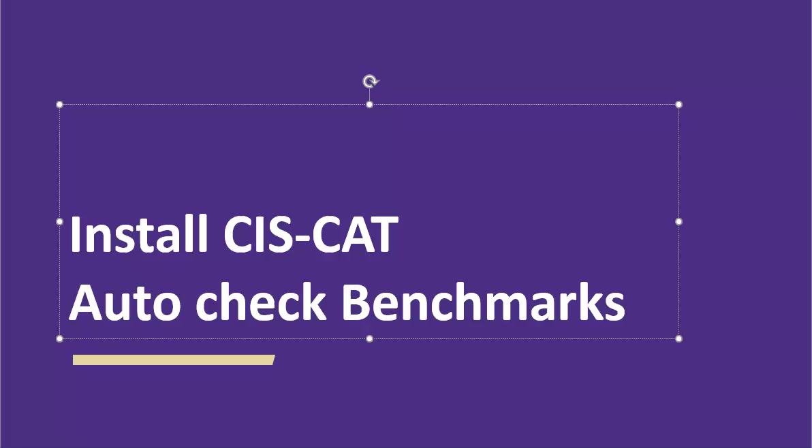

Slide 31
The End… until next time.
¯\_(ツ)_/¯
… …
Check Secure Configs
Use CIS-CAT
Disable services/ports not needed (LLMNR & SMBv1)
Or just use Azure/AWS pre-made images via Marketplaces.
Enable Logs
Use CheatSheets
https://www.malwarearchaeology.com/cheat-sheets
Enable PowerShell Script Block Logging
Monitor more bad behaviors not typically in logs with Sysmon
Notes:
Check Secure Configs (CIS-CAT) assessor tool
Disable SMB going Outbound your internal Network. No reason to go to internet.
2. Enable Logs with cheat sheets.
3. Monitor your logs for badness
ADVANCE:
Patch your Software and OS (Or Place in a Secure Enclave)
Configure Firewalls inbound and outbound (SMB/LLMNR are LAN protocols not a WAN, so block outbound to Internet)
Lastly Simulate Adversary Tactics to obtain Detection mechanisms (behaviors) to create more monitors/detections.
NEXT SLIDE: Rocky sleeping with Bitly to obtain resources.
Free Tools to Review/Monitor/Log: MSFT Sysinternals: Sysmon, built-in Windows Audit logs, cmd line auditing, and PowerShell, Registry Monitoring (turn on)
My Wiki: https://wiki.cac.washington.edu/display/~moorej1@washington.edu/IR+Sandbox+Powershell+Obfuscation+and+Detection+Techniques
PowerShell v5 Security Enhancements & AD Security https://adsecurity.org/?p=2277
Ask your vendor for best practices or free tools that come with contract such as ATP
BloodHound Map AD https://github.com/BloodHoundAD/BloodHound
MSFT cloud https://cloudblogs.microsoft.com/microsoftsecure/2018/08/13/cybersecurity-threats-how-to-discover-remediate-and-mitigate/
https://gallery.technet.microsoft.com/Azure-Security-Center-549aa7a4
RegMon: http://leelusoft.altervista.org/registry-live-watch.html
https://sourceforge.net/projects/regshot/
Team should have a mission and plan to guide them what is important to business. Could implement CyberSecurity Framework, Or Map the CIS Controls (core of NIST) to objectives. Map those to Tickets to track events related to controls for later analysis.
Cybersecurity Framework (CSF) Core: Identify, Protect, Detect, Respond, Recover
For an example of Detection Response team mappings:
Protect: CIS 3, Secure Configuration of End-User Devices
Detect: CIS 4, Continuus Vulnerability Assessment & Remediation
Respond: CIS 6, Maintenance, Monitoring, and Analysis of Audit Logs

Slide 32

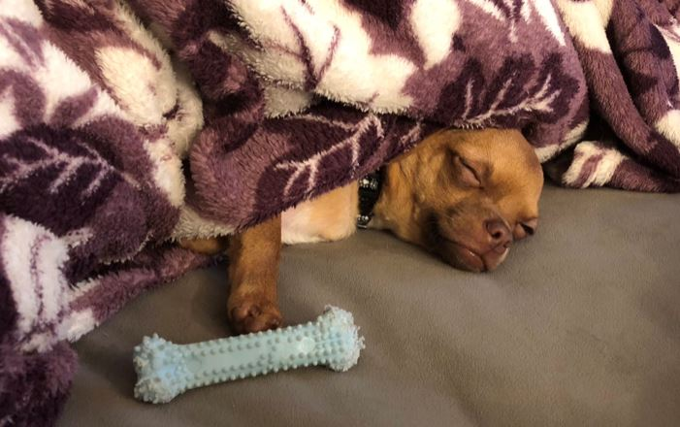
Yep, that was a lot…
Contact info: moorej1@uw.edu Twitter: @jessefmoore
Download Resources Here: http://bit.ly/AdversaryTactics
Notes:
Any questions?

